Slide 1
HTML FORM

Slide 2
Form TAGS
Html form tags are used to create login, registration, signup forms etc..
By using block level tag <form> </form> we can create from.
By using <input> tag we can give different types of inputs.
Input tag is also known as unpaired tag.
By using input we can insert Text, Number, E-mail, Password, Button etc..
By using <label> </label> tag we can provide additional information.

Slide 3
Placeholder It is an attribute which is used to display the watermark text in the input box.
Basic data validations in html forms
Required It is used to create mandatory fields in the form.
Pattern It is used to check user entered data whether it is in specific format or not.
Ex : [a-z] here only small a-z alphabets can be entered.
Button It is used to trigger an event. Some of the buttons we used in form are submit, reset, Apply Etc.

Slide 4
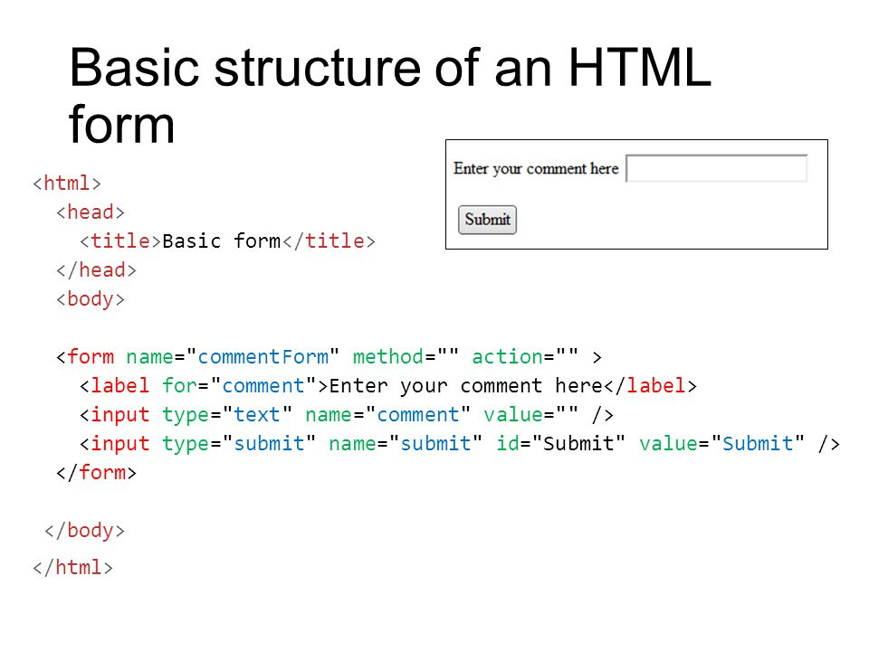

Slide 5
THANK YOU

